Slide 1

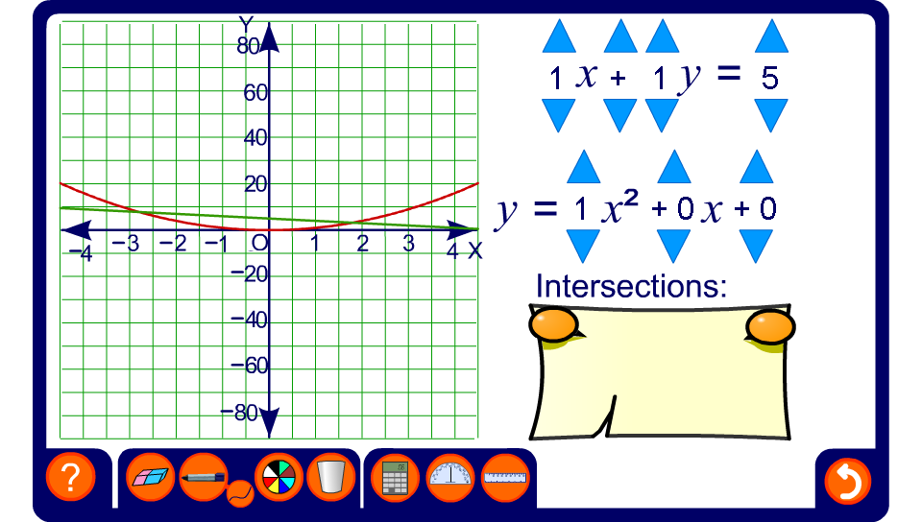


Linear and quadratic graphs
Notes:
Use this activity to demonstrate solutions to simultaneous equations where one equation is linear and the other is quadratic in x.
Establish that most solutions do not involve whole numbers. Conclude that the graph is a good way of visualizing the solutions but that an algebraic method will give more exact answers.
Investigate examples where there is only one pair of solutions and where there are no solutions.

